Slide 1
Model Based Testing for Java and Web applications.
Jeffrey Feldstein
Cisco Systems
jbf@cisco.com
jbf@sherpas.com
Source Code: http://www.sherpas.com/mbt

Slide 2


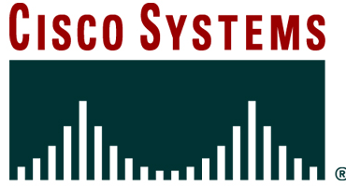
Presentation_ID
© 2004 Cisco Systems, Inc. All rights reserved.

Slide 3

Agenda
Introduce myself
Model Based Testing Introduction
Obstacles to Model Based Testing
Introduction to IBM Functional Tester
Model Based Test demonstration
Code walk-through
How to obtain and run the source
Next Steps

Slide 4

Introduce Myself
Software Career: 25 years
Software Test: 7 years
Test Automation: 6 years
Current position at Cisco:
  Manage a group of 65 test engineers located in San Jose, India (2 sites) and Netanya, Israel, testing a next generation Network Management Platform (Active Network Abstraction)

Slide 5
Test Automation
What are some of the problems that you have seen with test automation ?

Slide 6

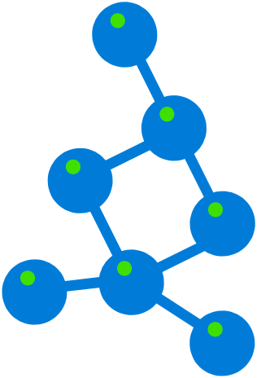
What is a Model?
An abstract representation of your application, stored in memory, that enables a test program to navigate your application.

Slide 7
Vocabulary: States & Transitions
A State is a screen or other place where an application waits for further input
A transition is a screen object, keyboard input or other stimulus that causes the application to move to a new state

Slide 8

Model Based Testing Introduction
Application represented as a Model
Model is stored as a finite-state-machine (FSM) or tree
The FSM contains application states and all possible transitions
Test Case flow is not predetermined
Can more closely emulate the customer’s use
New Test Cases are generated on the fly

Slide 9

Model vs. Classic Automation
Classic automation is 100% repetitive
Nothing changes from one run to the next
Data-Driven Automation: Data might change but flow through the program stays the same
Model-based testing introduces randomization of test flow
Can find bugs you aren’t looking for

Slide 10
Model Based Testing Introduction (con’t)
Best introduction:
  http://www.geocities.com/harry_robinson_testing/robinson.pdf
  Google: “Harry-Robinson Intelligent”
Model is stored as a finite-state-machine
The finite-state-machine is then navigated by a choice of algorithms
Each state usually corresponds to an application screen
Normal automation scripts can be run for each state
Transitions can be weighted with a probability to ensure a node is visited more (or less often)

Slide 11
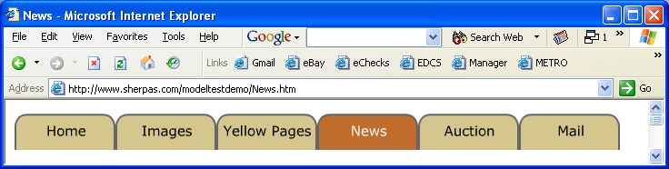
A simple Model
Web Page Tabs
Each tab is a state
User can navigate from any state to any other state

Slide 12
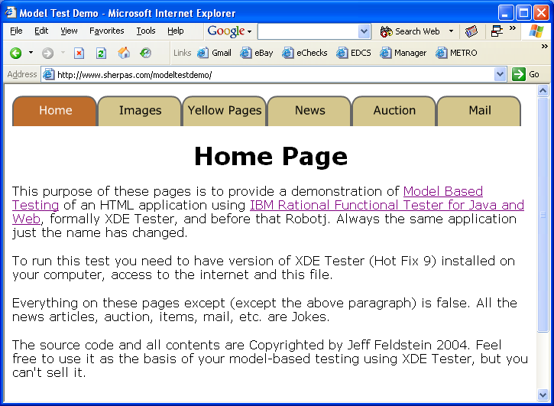
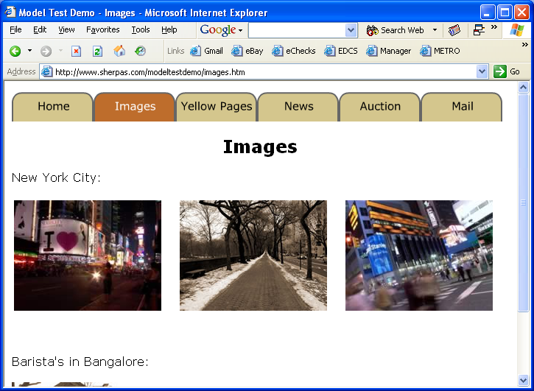
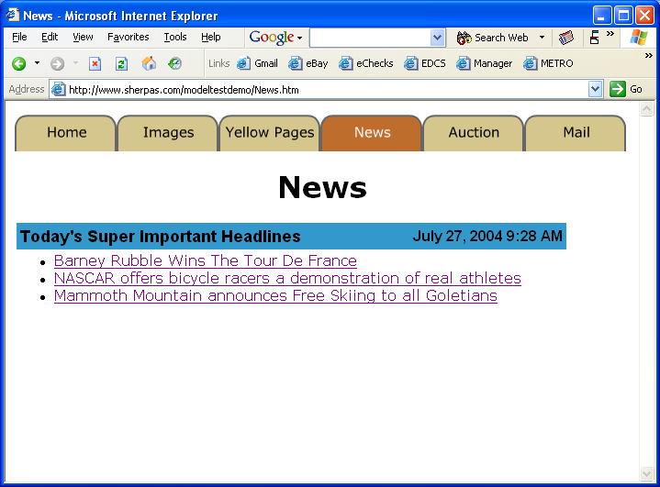
A simple Model: With transitions
Home
Images
Home
Home
News
Images
News

Slide 13
A simple Model: With transitions
Home
1
Images
Home
Home
News
4
Images
3
News
2

Slide 14

Model Based Testing Advantages
Introduces a sense of randomness to testing
Can form the basis of a “soak” test
Interesting software development for testers
Navigation through the states can be predetermined, randomized or both:
  Random
  Shuffle
  Directed (Breath or Depth first)
Can run indefinitely, until every node is visited, or for a set amount of time

Slide 15

Model Based Testing Obstacles
Requires complex data structures to store and manipulate the model
Full-powered programming language required for implementation
Can not easily be implemented in many of XDE Tester’s competition
Relatively high level of software engineering knowledge is required (for a test department)
Without careful logging and playback ability, problems can be difficult to reproduce
Business logic to verify function needs to be modular

Slide 16

IBM Rational Functional Test For Java & Web
Formally Known as XDE Tester
AKA “robotj”
Java is the scripting Language
Eclipse is the IDE
GUI Map stored as an XML file
ScriptAssure: Manages GUI Changes
In Production use by Cisco for 18 months

Slide 17

Demonstration

Slide 18
Directed Transitions
The Model contains all possible transitions
Business logic must still be verified
In cases where the data entered determines which transition to choose, it’s the job of the business logic verification to determine if the behavior of the program was correct.
Example:
New User Dialog
Login
Exiting User Screen

Slide 19
Main Java objects
Array of states
Transition list
Transition properties
Verification procedures to call

Slide 20
Java objects: State Details
class State {
public int m_state;
public transitionList m_transitions;
public String m_stateName;
public boolean bVisited;
public int distToDest;
public int transitionToDest;
// Method VerifyMethod;
String VerifyMethod;
State(int s)
{
bVisited = false;
m_state = s;
m_transitions = new transitionList();
}
}

Slide 21
Java objects: Transition Details
public class transitionList {
private java.util.List list = new ArrayList();
public void add(transition m)
{ list.add(m); }
public transition get(int index) {
return (transition)list.get(index);
}
public int size() { return list.size(); }
}
public class transition {
public GuiTestObject m_trigger;
public State m_destination;
public transition(GuiTestObject o, State s){
m_trigger = o; m_destination = s;
}
}

Slide 22
Sample Code Features
Implements a Model Based test for a simple application
Can scale to much larger applications
Navigation:
  Random
  All Paths
Timed Execution
HTML log for test status
XML Log for replay

Slide 23
Conclusions
A Model of an application contains states and all possible transitions into and out of those state
Model Based Testing will find more bugs because of the random nature of the navigation
Model Based Testing, like classic automation requires good back-end or business-logic verification
Model Based Testing requires good software engineering skills

Slide 24
Obtaining & Running the Sample Code
Obtain a copy of Functional Test for Java
http://www-306.ibm.com/software/awdtools/tester/functional/
Click on “Trials and Betas” on the right
This page is the test application and contains directions for downloading and running the code”
http://www.sherpas.com/mbt

Slide 25


MBT - Further Reading
IBM Developer Works
  http://www-128.ibm.com/developerworks/rational/library/05/r-3175/
Software Test & Performance Magazine (Feb 2005)
  http://www.stpmag.com/issues/stp-2005-02.pdf

Slide 26
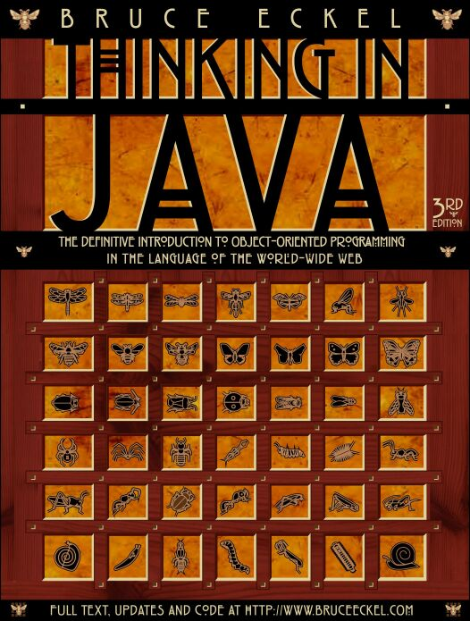
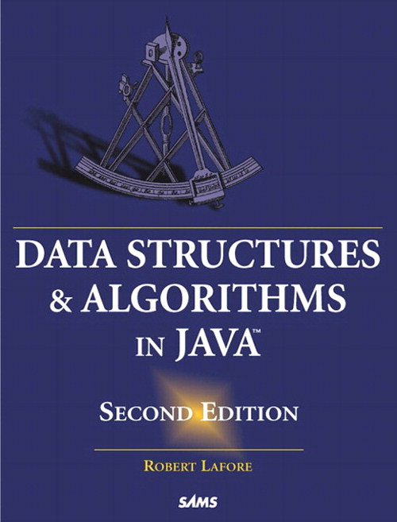
Learning Java
Thinking In Java
  by Bruce Eckel
  http://www.mindview.net/Books/TIJ/
Data Structures and Algorithms in Java
  by Robert Lafore

Slide 27


Questions?
sherpas.com/mbt

Slide 28
Presentation_ID
© 2004 Cisco Systems, Inc. All rights reserved.

